Slide 1



Introducing a New Application Aoi Sora
x
Proposed by AURA ORIENTALIS team

Slide 2
AGENDA
01
Aura Orientalis Introduction
02
Aoi Sora Introduction
Overview
Introduction to IT Division
Introduction to System Manager
Key Differentiators Aura Orientalis Can Deliver
Demo
Development Schedule
Discussion

Slide 3

01
Aura Orientalis Introduction

Slide 4
1. Aura Orientalis Introduction _Overview
私たちの使命は、私たちの製品とサービスを通して、お客様、その周りの人々、地球環境に、心地よい穏やかな世界を創造することです。
System Development
Handicraft Products
Trading
Services

Slide 5
1. Aura Orientalis Introduction _Key Differentiators Aura Orientalis Can Deliver
Technical Expertise
Solution Capabilities
Training
& Knowledge Sharing
Continuous Partnership

Slide 6









1. Aura Orientalis Introduction _Key Differentiators Aura Orientalis Can Deliver
Technical Expertise
1. Applications & Systems
2. Cloud
Platforms
3. Databases
4. Flexible Solutions
Aura Orientalis provides a solid technology foundation
— the “backbone” for sustainable business growth.

Slide 7
1. Aura Orientalis Introduction _Key Differentiators Aura Orientalis Can Deliver
Solution Capabilities
Experience of Technical Leaders & Team
Operational Understanding
.
Tailored Software Design
Notes:
Solutions come from the practical experience of our Technical Leaders and company team: many years working in supermarket and retail environments, with deep understanding of industry-specific operations
Our team has the ability to understand business operations while continuously learning to propose targeted solutions
We deliver software designs that fit real-world needs, addressing root problems rather than just handling surface issues.

Slide 8
1. Aura Orientalis Introduction _Key Differentiators Aura Orientalis Can Deliver
Training
& Knowledge Sharing
1. Commitment to Training
2. In-Depth Knowledge
3. Reduced Dependence
4. Proactive Mastery
Aura delivers knowledge and self-reliance, enabling businesses to grow sustainably without relying on external support.
Notes:
Aura provides direct training to your team on relevant operational and technological knowledge.
Not just teaching system usage, but also guiding how to build and manage a complete system.
Your business can confidently operate, modify, and expand the software in the future.
Clients don’t just “use the system” — they fully understand the technology behind it.

Slide 9
1. Aura Orientalis Introduction _Key Differentiators Aura Orientalis Can Deliver
Continuous Partnership
1. Continuous Support
2. Updates & Improvements
3. Strategic Partner
4. Sustainable Value
With Aura, clients don’t just have a technology provider — they gain a reliable partner for long-term development.
Notes:
Always ready to resolve issues arising during operations.
Systems are regularly upgraded based on real needs and emerging trends.
Aura does more than provide software — we accompany you as a trusted partner in your growth journey.
Ensures the system remains relevant, efficient, and aligned with your business’s growth.

Slide 10
02
Aoi Sora Introduction

Slide 11
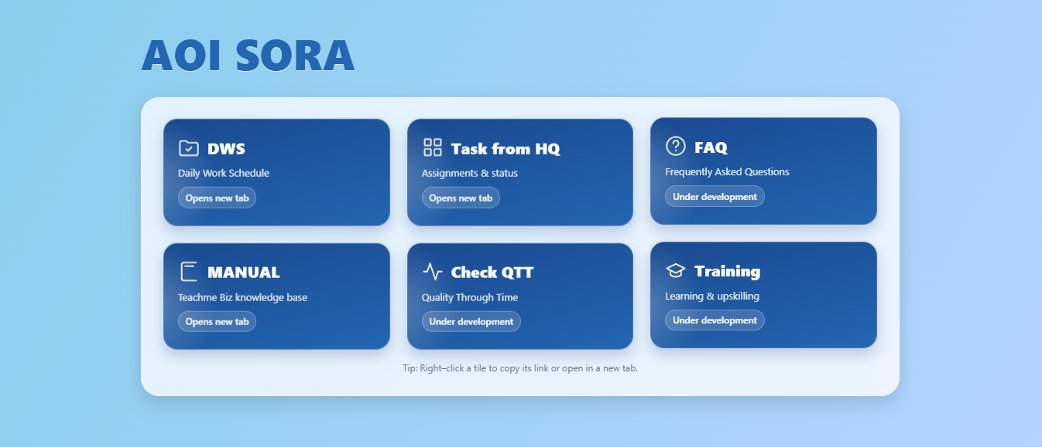
2. Aoi Sora Introduction _Introduction to the Task Management Project

Slide 12
2. Aoi Sora Introduction _Introduction to the Task Management Project
Timeline phat trieenr:
Tháng 10: ký hợp đồng Sau khi hoàn tất thủ tục ký hợp đồng: 2 tháng Bàn giao sử dụng: tháng 1 2026

